Slide 1
4th Year Project
Sara Kosciuczuk IDAD4 C00251415

Slide 2
01
What?
My project is a digital art book which will contain art for a game concept, along with VFX programming for chosen 3D models.
The final outcome will be presented on a website page.

Slide 3
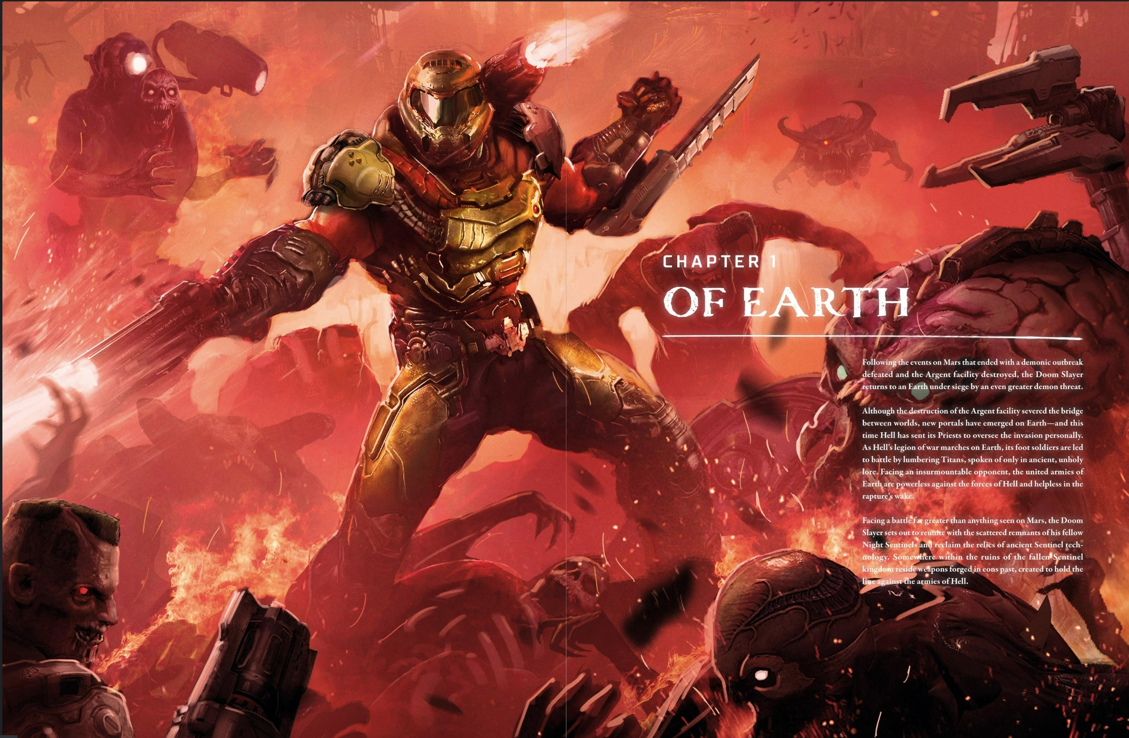
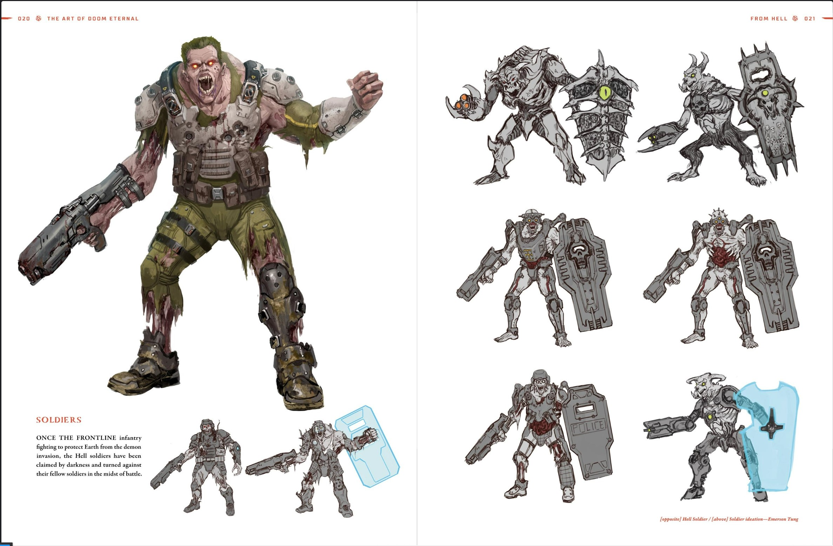
Examples from Doom Eternal

Slide 4
What?
It will have a short story including backstories for characters.
The game genre will be an RPG because I think it is more customisable with different characters, creatures and weapons.

Slide 5
02
Why?
I chose this project because I would like to pursue a career in concept art for a game studio and it would also be great to show off in my portfolio.

Slide 6
How?
03
Researching about creatures, concept art and layouts of digital art books.
Looking for suitable VFX for chosen 3D models and how to present everything on a website.
These are the most important because it will have the most impact on the core of my project.

Slide 7
Programs I will be using
Visual Studio Code
Maya
For 3D modelling.
For coding in python, html, css and javascript.
Photoshop
Website
To create concept art.
To present everything on a website.

Slide 8
Workflow
Mood boards
3D Models
Website
01
02
03
04
05
06
Research
Concept Art
VFX

Slide 9
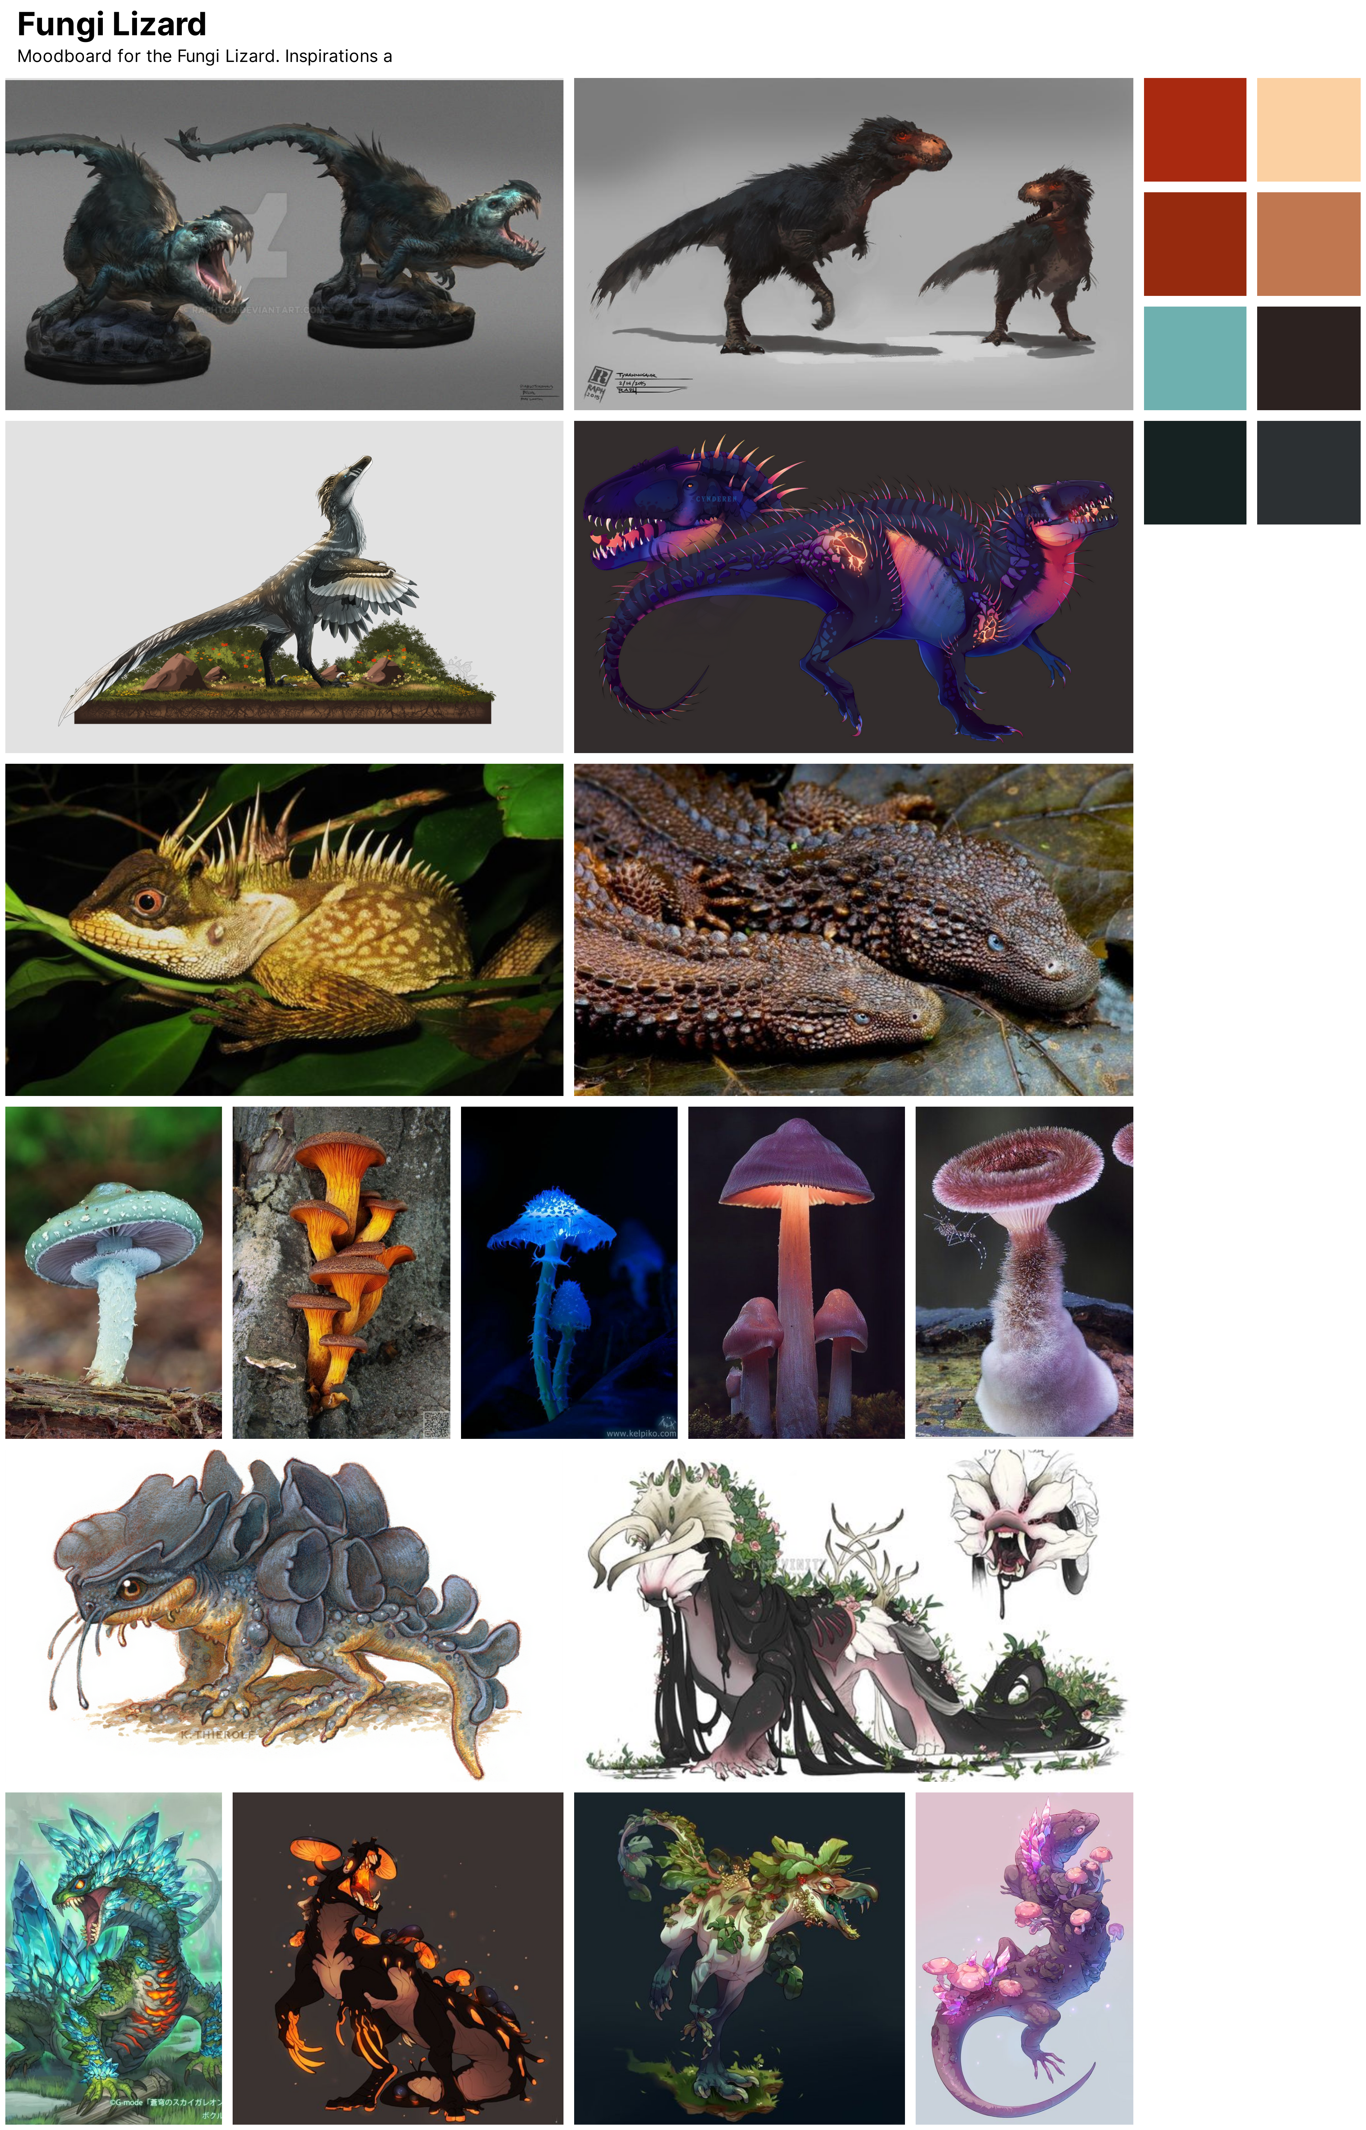


Slide 10
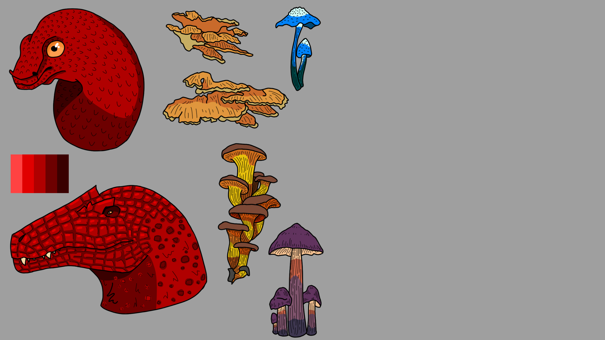
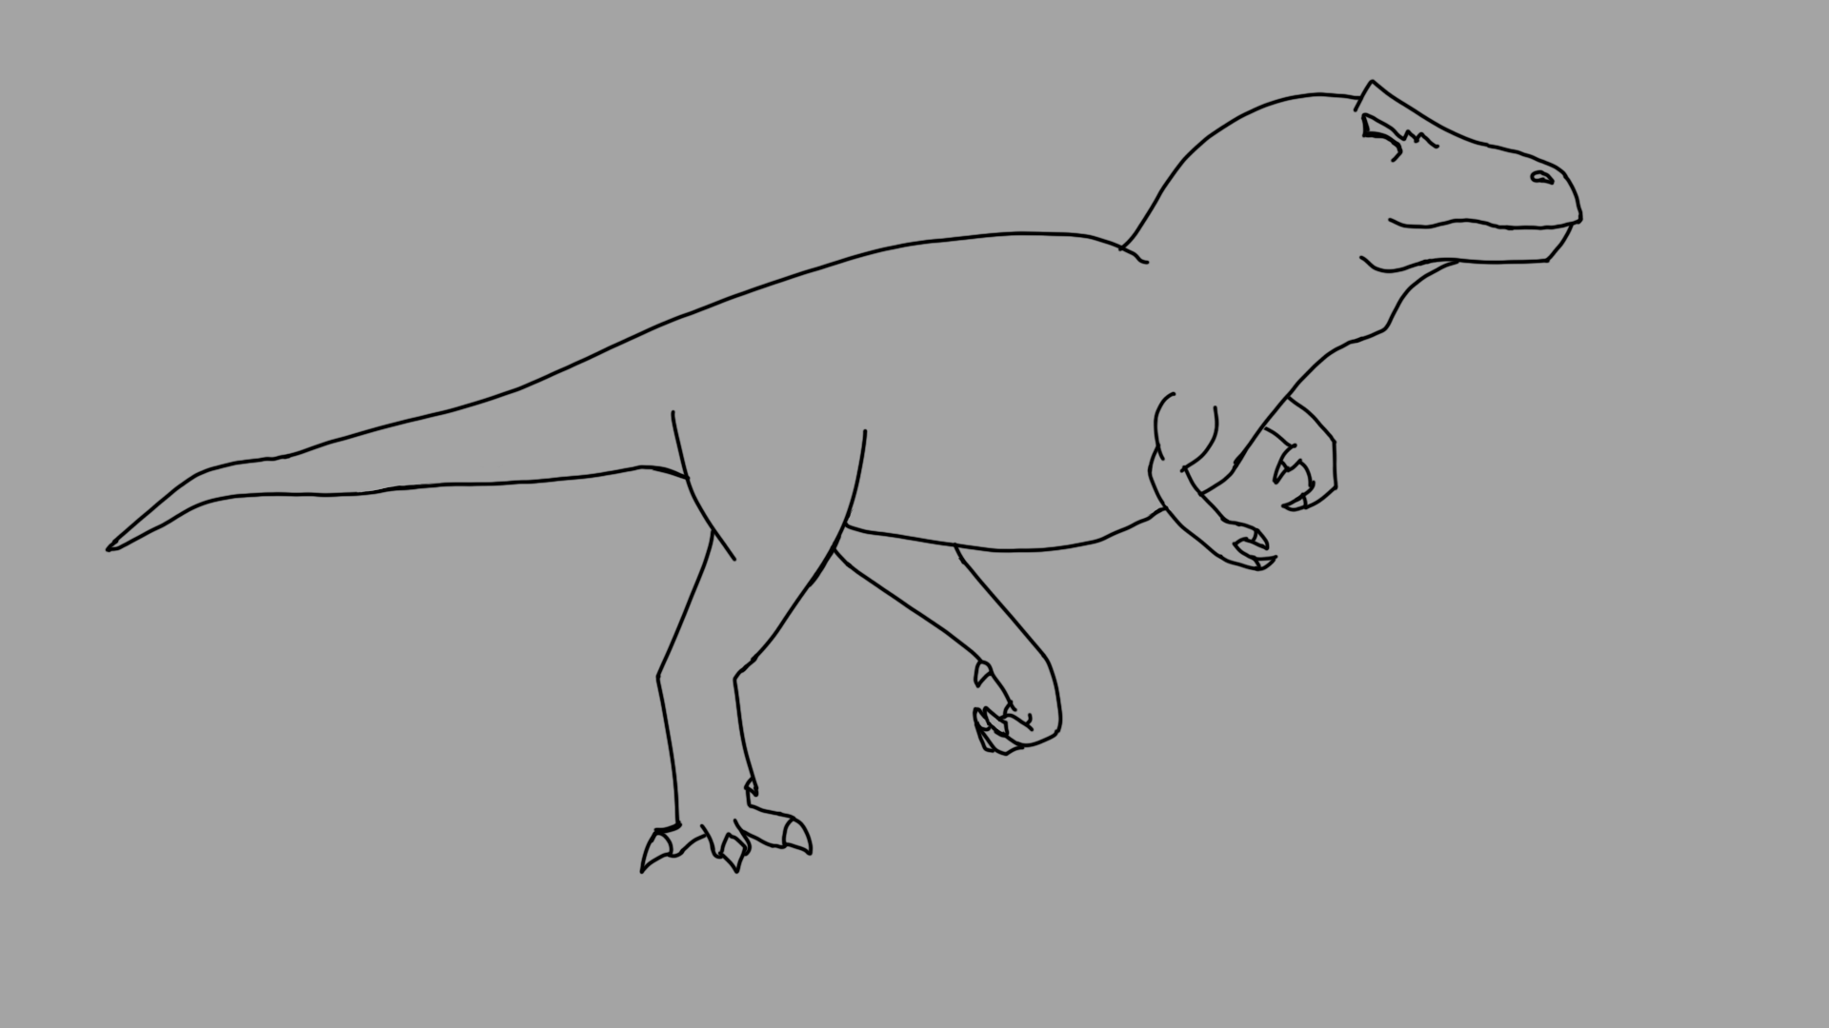

Slide 11
Thanks!
Any Questions?
https://github.com/SaraKosciuczuk/4th-Year-Project

